Slide 1


“PROBLEM NUMBER:01”
“TEAM MATES”
PRATHAM
VARSHINI
JOVIN
1.LIKITH

Slide 2
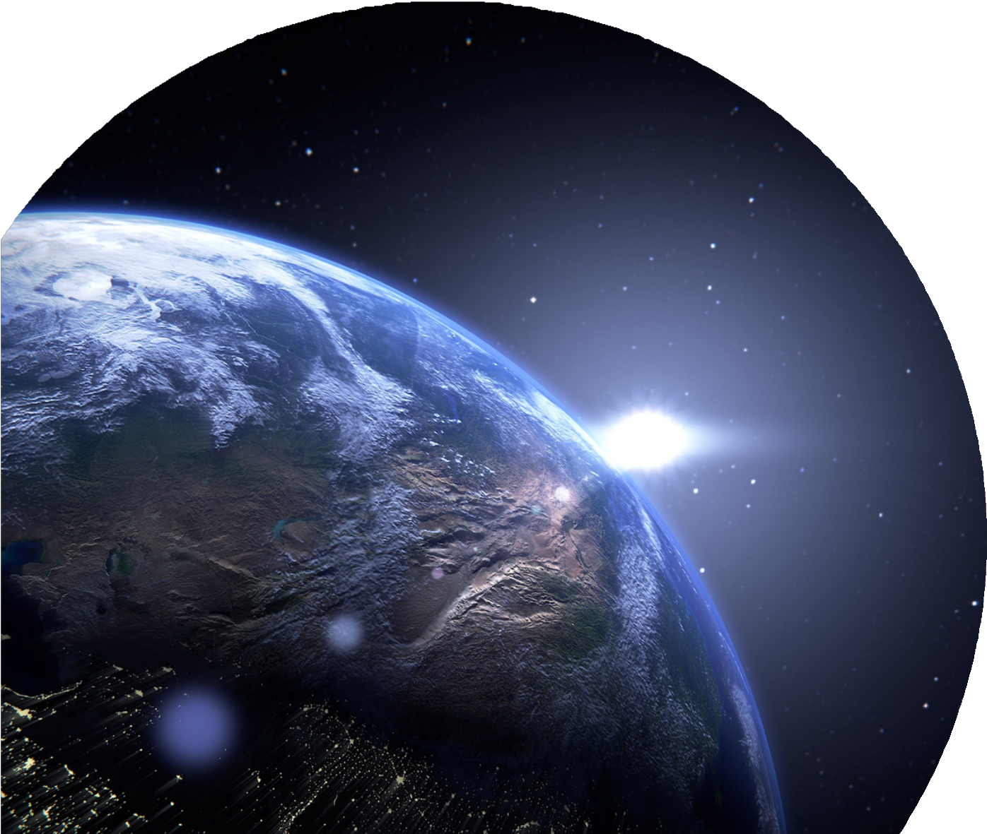
“PROBLEM UNDERSTANDING”
Improved Analysis Accuracy – Normalizing brightness ensures that analyses (e.g., change detection,
classification) are based on actual surface changes, not lighting variations.
Better Machine Learning Results – ML models perform more reliably on standardised data, reducing
training errors and improving predictions.
Enhanced Visual Interpretation – Consistent brightness helps experts visually analyse and interpret satellite imagery more effectively.
Crucial for Time-Series Data – When monitoring changes over time (e.g.,
deforestation, urban expansion), normalisation helps ensure comparability across images.

Slide 3
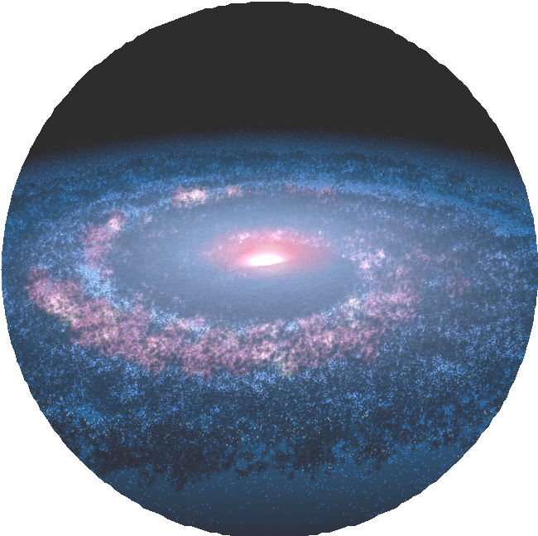
“PROGRAM”
“TO FIND SATELLITE IMAGE BRIGHTNESS NORMALIZER”

Slide 4

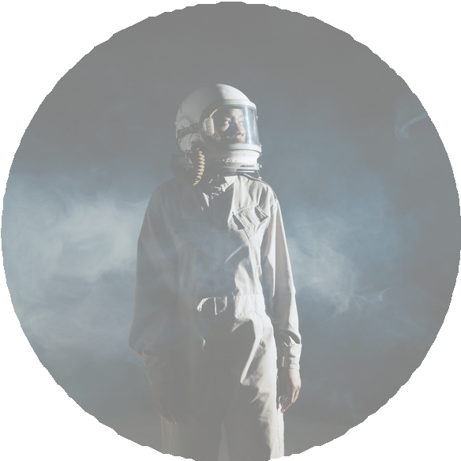
ALGORITHM
Step1: Load the image from the given file path.
Step2: Convert the image to grayscale (black and white). Step3: Get the pixel values from the image as a 2D array.
Step4: Normalize pixel values from range 0–255 to range 0–9:For each pixe(pixel_valu/ 255) * 9 Step5 : Round the result to the nearest whole number.
Step6: Scale the values from 0–9 to range 0–225: Step7: For each pixel: pixel_value * (225 ÷ 9) Step8: Convert the pixel array back to an image.
Step9: Save the new image to the given output path. Step10: Print a message confirming the image was saved.

Slide 5
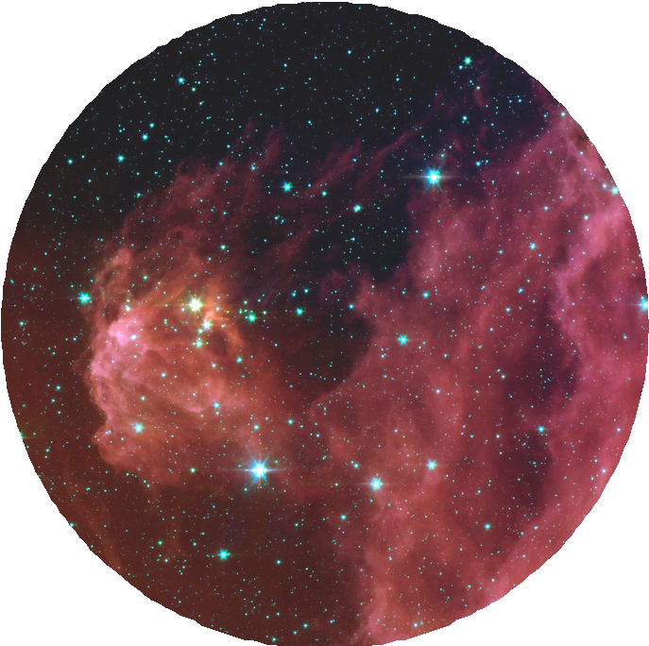
“pseudocode”

Slide 6
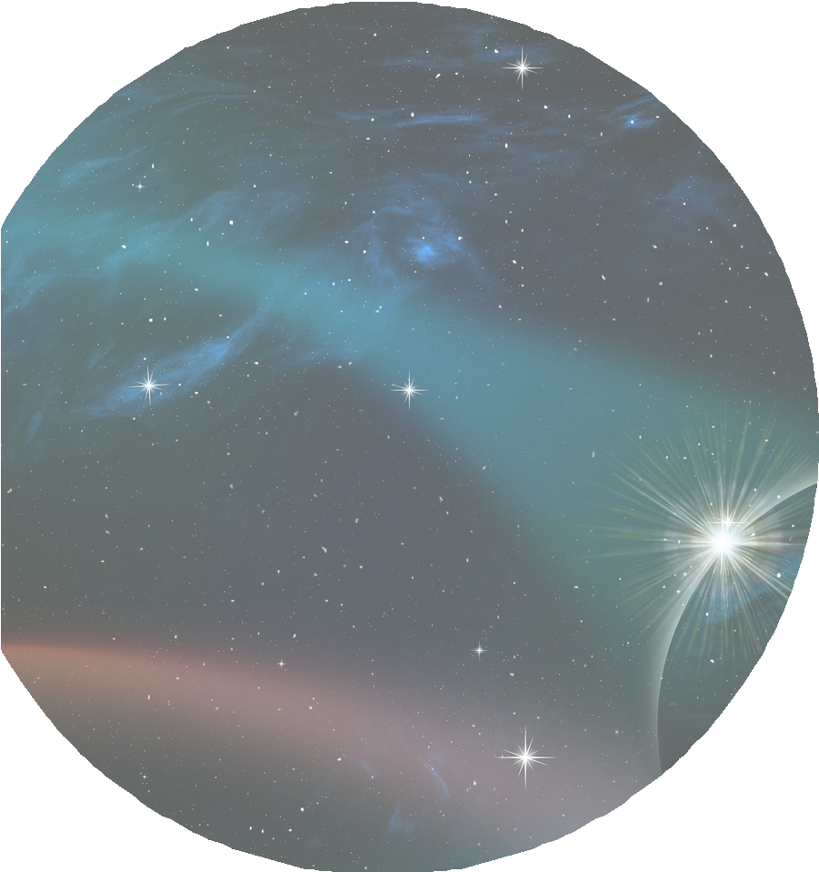
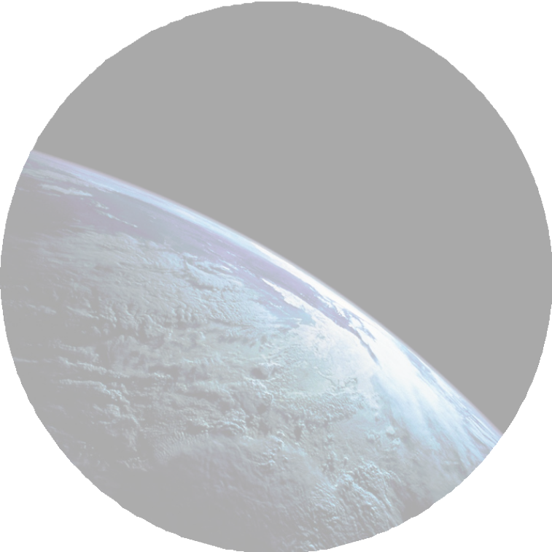
“Introduction: Problem overview and objectives”
Overview :Satellite imagery is critical for applications like environmental monitoring and urban planning, but variations in brightness across images can skew analysis. The Satellite Image Brightness Normalizer challenge requires teams to develop a program that normalizes the brightness of 10 grayscale PNG images (256x256 pixels) to match a global average intensity (e.g., 127.5 for the sample test case). The goal is to ensure each output image’s average intensity is within ±1 of the global average, preserving image quality for downstream processing.
Objective: Read a ZIP file containing 10 grayscale PNGs, normalize their brightness, and output 10 normalized PNGs named normalized_image1.png to normalized_image10.png.
Implementation Details: Language used:python

Slide 7
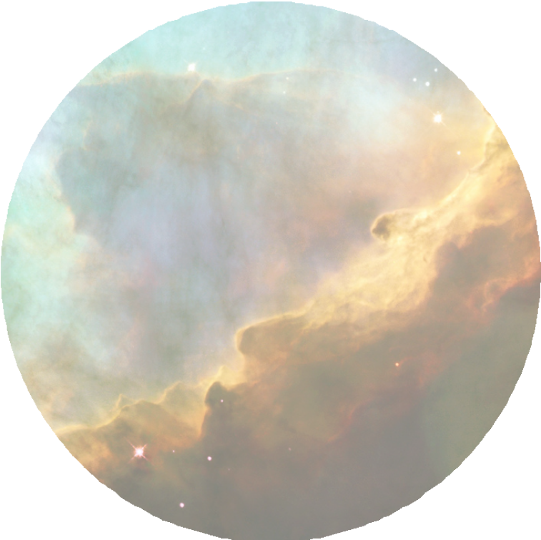
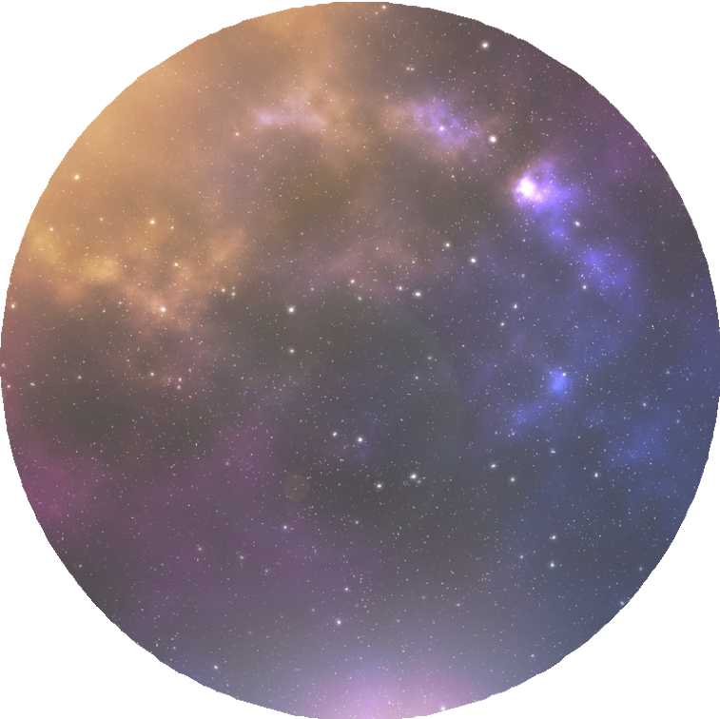


“CHALLENGES AND SOLUTIONS”
* Precision/Encoding Differences:
Issue: C++ might use high-precision floats or specific encoding that's misinterpreted in Python.
Fix: Agree on encoding (UTF-8 is safe), and use consistent floating-point precision formatting.
Issue: Python tries to read data before C++ writes it completely Issue: Python outputs data in a format C++ doesn't parse correctly.
*. File Handling/Paths:
C++ might read from the wrong path or at the wrong time.
we faced problem in hedder files in C++ and we got the output in Python..

Slide 8
RESULTS:
“input image”
“output image”
TOOLS USED : VSCNVA,VSGDB.
REFERENCE:CHATGPT,BROWSER.

Slide 9


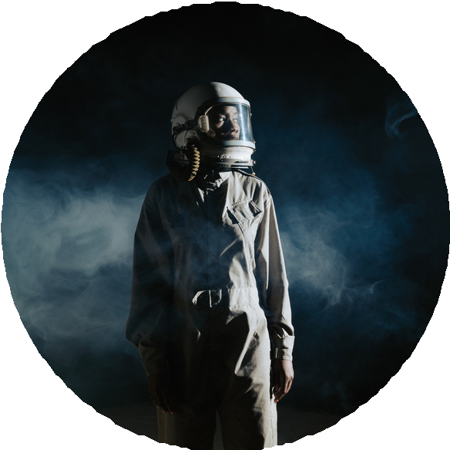
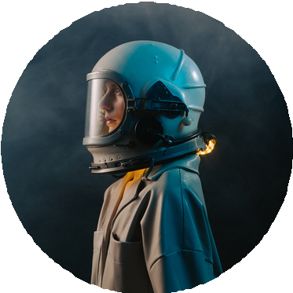
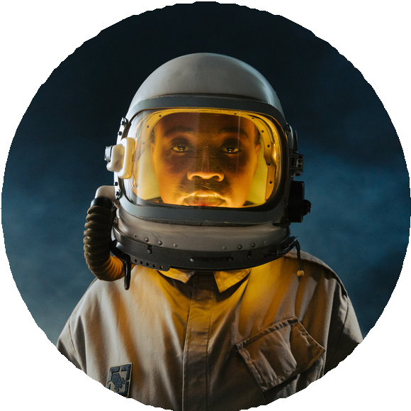
PRATHAM
DEVELOPER/ DESIGNER
VARSHINI
DATA ANALYST
JOVIN
DESIGNER
LIKITH
DEVELOPER

Slide 10



